Slide 1

AgroRent: A Centralized Equipment Rental System

Slide 2

01
Problem and Solution Overview
Contents
02
System Architecture and Design
03
Database Implementation
04
Data Analysis and Queries
05
Conclusion

Slide 3

PART 01
Problem and Solution Overview

Slide 4
Problem Identification
Challenges in Equipment Rental
System Requirements
Farmers who are new to organic farming often struggle to find reliable equipment at fair prices due to limited experience and dependence on multiple vendors. Unclear pricing and the absence of a trusted rental source make the process costly and confusing, discouraging many from switching to organic farming. This creates a need for a centralized system that provides easy access to farming equipment with transparent pricing and assured availability.
Functional Requirements:
User registration and secure login
Equipment listing and management by owners
Search and filter equipment (type, location, availability)
Equipment booking and reservation system
Payment recording and transaction tracking
Ratings and reviews for equipment
Admin control for managing users and system data
System Features:
Web-based platform with database backend
Booking and payment management modules
Dashboard for users and administrators

Slide 5
PART 02
System Architecture and Design

Slide 6
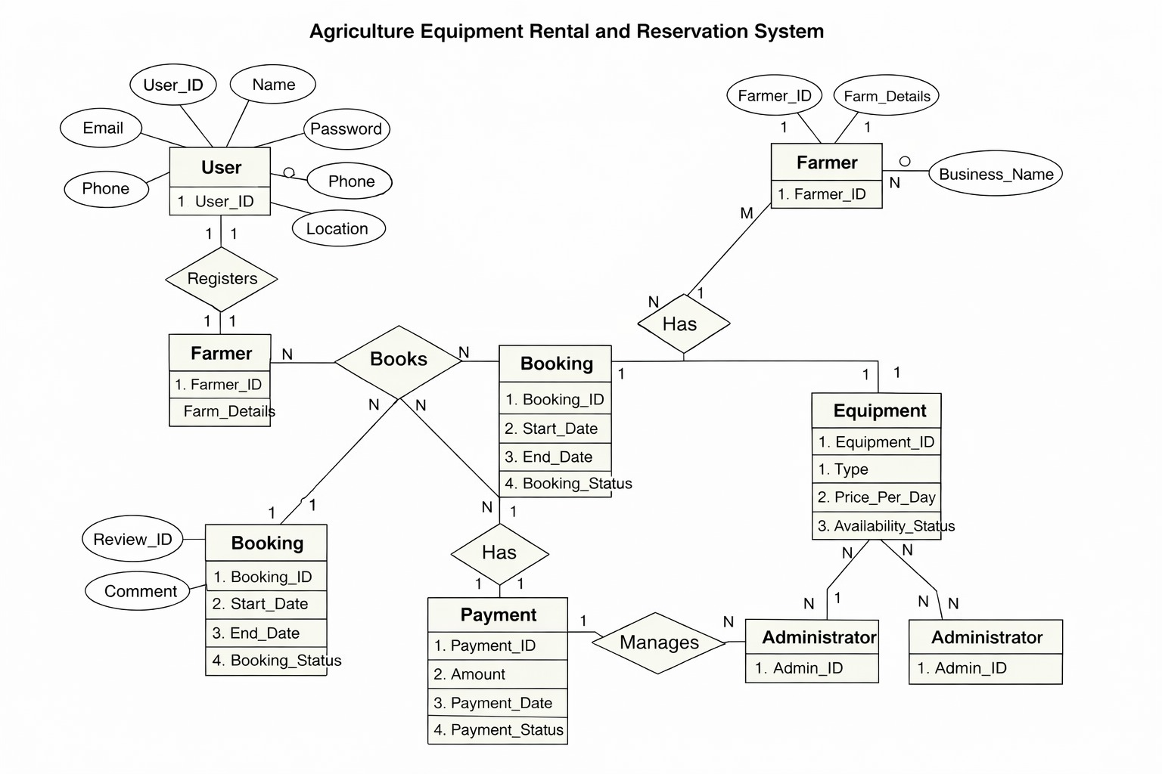
ER Diagram
The ER diagram represents the structure of the AgroRent system and shows how different entities are interconnected.
The Users entity acts as the base, with Farmer, EquipmentOwner, and Administrator derived using inheritance for role-based access.
An EquipmentOwner can manage multiple equipment, forming a one-to-many relationship.
The Booking entity resolves the many-to-many relationship between Farmer and Equipment, allowing multiple bookings from both sides.
Each Booking is linked to exactly one Payment, ensuring proper transaction tracking.
The Review entity stores ratings and feedback, creating relationships between farmers and equipment.
Overall, the ER model ensures efficient data organization and maintains integrity through well-defined relationships.

Slide 7
UML Diagrams
UML diagrams describe both the structure and behavior of the system.
The Use Case diagram shows interactions between users and system functionalities.
The Class diagram represents the system’s structure and relationships between entities.
The Sequence diagram illustrates the step-by-step flow of booking and payment processes.
The Activity diagram explains the overall workflow from searching equipment to completing a booking.
Each entity in the ER diagram has been converted into a corresponding class in the Class Diagram.
For example, USER is represented as the User class, while FARMER, EQUIPMENT_OWNER, and ADMINISTRATOR are modeled as subclasses using inheritance.
The BOOKING entity resolves the many-to-many relationship between FARMER and EQUIPMENT, and this relationship is preserved in the Class Diagram through associations with correct multiplicities.
The PAYMENT entity maintains a one-to-one relationship with BOOKING, which is also preserved.
The REVIEW entity maintains one-to-many relationships between FARMER and EQUIPMENT.
The Use Case, Sequence, and Activity diagrams reflect the functional requirements defined in the SRS

Slide 8
PART 03
Database Implementation

Slide 9
Relational Schema
Concept | Explanation | Example (SQL / Data)
Entity → Table Mapping | Each entity from the ER model is converted into a table in the relational schema. | Users(user_id, name, email)
Primary Key | Uniquely identifies each record in a table. | user_id INT PRIMARY KEY
Foreign Key | Establishes relationships between tables. | owner_id REFERENCES EquipmentOwner(owner_id)
One-to-Many Relationship | One owner can manage multiple equipment. | Equipment → owner_id
Many-to-Many Relationship | Resolved using a bridge table (Booking). | (farmer_id, equipment_id) in Booking
One-to-One Relationship | Each booking has exactly one payment. | booking_id UNIQUE in Payment
NOT NULL Constraint | Ensures mandatory fields are not empty. | name VARCHAR(100) NOT NULL
UNIQUE Constraint | Prevents duplicate values. | email UNIQUE
CHECK Constraint | Restricts values within a range or condition. | rating BETWEEN 1 AND 5
DEFAULT Constraint | Assigns default values if none provided. | status DEFAULT 'Pending'

Slide 10
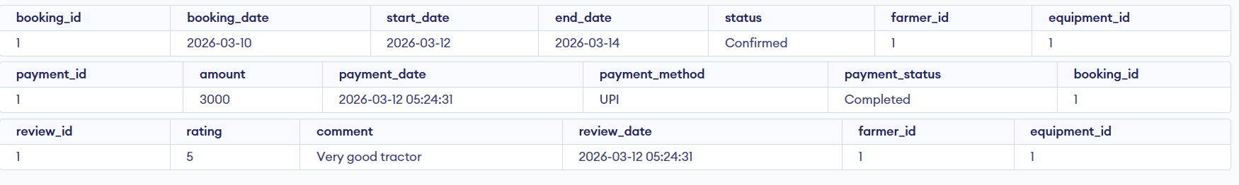
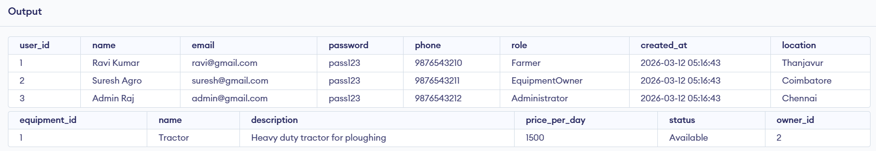
DDL & DML
The system uses DDL (Data Definition Language) to define and modify the database structure, and DML (Data Manipulation Language) to manage the data stored in the tables.
DDL operations are used to create tables and define their structure, such as creating tables for users, equipment, and bookings, and modifying them by adding new attributes when required.
DML operations are used to handle data within these tables. For example, new users or equipment can be added to the system, booking details can be updated when a rental is completed, and unnecessary records such as reviews can be removed.
These operations ensure that the database structure is well-defined and that the data remains accurate and up-to-date throughout the system.

Slide 11
PART 04
Data Analysis and Queries

Slide 12

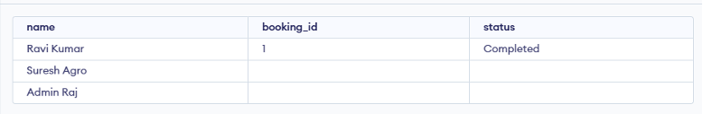
Joins & Aggregates
SQL queries use joins to combine data from multiple tables and aggregate functions to analyze and summarize the stored data.
Joins such as INNER JOIN are used to retrieve matching records, for example combining farmer, equipment, and booking details.
LEFT JOIN is used to include all users, even those who have not made any bookings.
Aggregate functions like COUNT, SUM, and AVG are used to perform calculations such as finding the total number of bookings, calculating overall revenue, and determining the average price of equipment.
GROUP BY is used to organize data into categories, while HAVING is used to filter grouped results based on specific conditions.
These operations help in extracting meaningful insights from the database and support better decision-making.

Slide 13
Project-Based Queries
Key Performance Indicators
The system includes several project-based queries that help generate meaningful insights from the database.
These queries are used to identify the most frequently booked equipment, determine which equipment generates the highest revenue, and retrieve the most recent bookings made by users.
The system can also identify farmers who have not made any bookings, which helps in understanding user activity and engagement.
Additionally, average ratings for each equipment are calculated using review data, allowing users to evaluate equipment quality based on feedback.
Overall, these queries support data analysis, improve decision-making, and enhance the effectiveness of the AgroRent system.

Slide 14
PART 05
Conclusion

Slide 15
System Benefits and Future Outlook
Centralized and Efficient System
AgroRent provides a centralized and efficient solution for renting agricultural equipment by simplifying access, improving transparency, and ensuring better resource utilization.
The system integrates key database concepts such as relational schema design, constraints, and SQL operations to manage users, equipment, bookings, and payments effectively.
By organizing data efficiently and enabling meaningful analysis through queries, the system supports better decision-making and enhances user experience.
Overall, AgroRent is scalable and can be further improved with features such as real-time payments, notifications, and mobile application support in the future.

Slide 16
THANK YOU

